Slide 1

Membership is a lot like Gardening

Slide 2
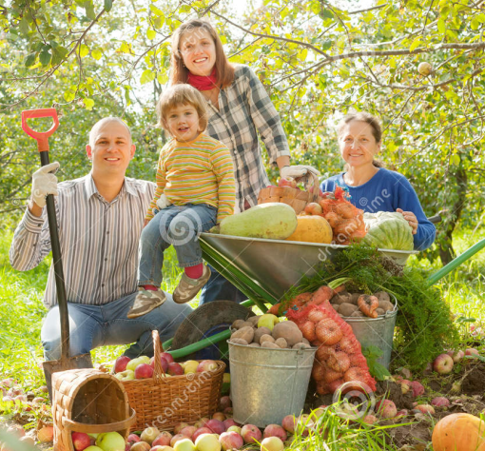
At the District & Club level
Every interaction has an impact on whether members leave or stay in a club,
Every interaction has an impact on whether clubs grow or decline…..

Slide 3
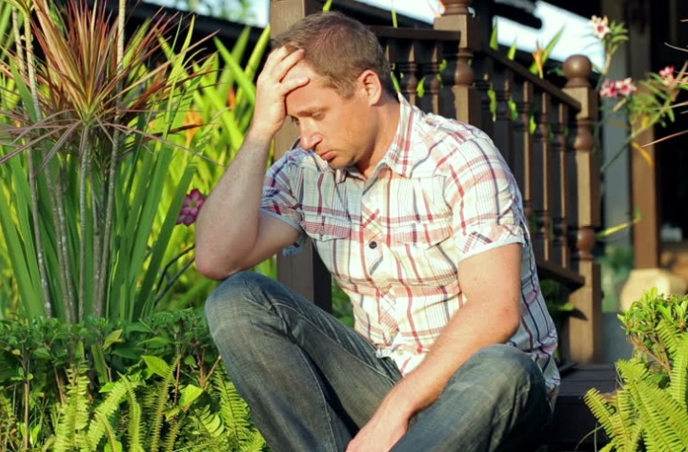
Why do members leave?
It is part of a club cycle to lose members,
Most members leave because they do not feel;
  Needed,
  Wanted, or
  Appreciated…

Slide 4

Why do members stay?
“People join to overcome their fear of public speaking
They stay because they made
REAL friends”
  Craig Senior DTM

Slide 5
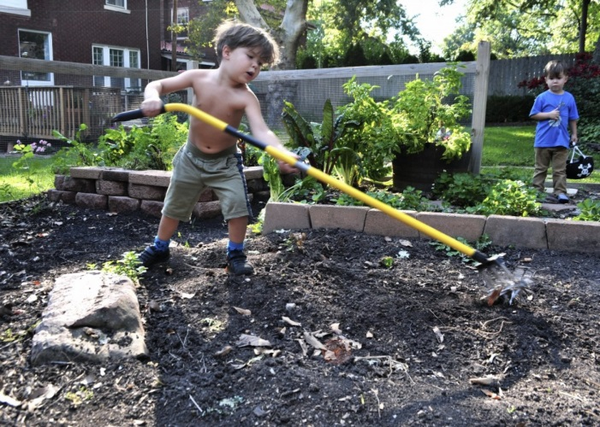
Why do members stay? cont….
Toastmasters is NOT a social club, BUT….
We ARE social creatures, if we do not feel nurtured, we leave…

Slide 6
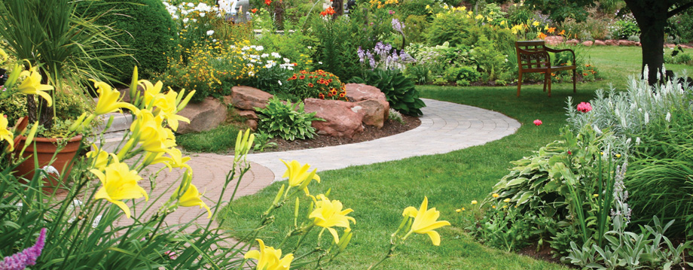
Why do members stay? cont….
To keep our members and have strong clubs we need to build strong relationships with our members!!!!!!!!!!
It starts with our first impressions…

Slide 7



The right soil for the right seed
- Matching guests to the correct member
Why did the guest come?
  Do we have a member who joined for the same reason?
What type of “personality” is our guest?
  Introvert?
  Extravert?

Slide 8
How to “interview” a guest
Family
Occupation
Recreation
Money (if applicable) i.e. club dues

Slide 9

The right soil for the right seed
- Matching members and to the correct mentor
Formal or informal mentoring?
Why did the member join?
Is the mentor available/willing…

Slide 10
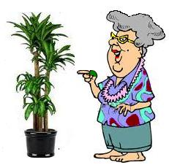
Plants need talking too
- Use the phone NOT email!
Email;
  Great to pass information (agenda, roster etc)
  Email is one way
  Externally poor to “read” people!
Phone;
  Phone is a two way conversation
  Human contact
  Allows to share…

Slide 11
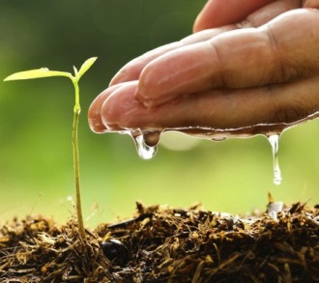
Watering and feeding
- Post-Toasties
Post-Toasties the all so important after the meeting meeting
Opportunity to:
  Socialize
  Go in-depth on a subject covered at the club
  Mentor
  Build the relationships….

Slide 12
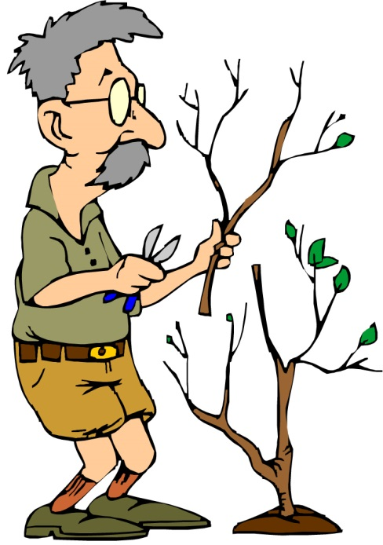
Pruning
- or, Leadership, when to let go
Leading is also learning to let go
Opportunity to:
  Mentor/Coach
  Learn new skills and/or
  Move on….

Slide 13

What’s next?
Implement your solutions
Measure effectiveness (if possible)
Share Lessons Learned

Slide 14
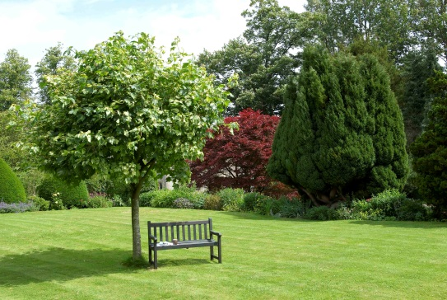
and
That’s it
Here is your chance to ask us what you never dared ask!
(Toastmaster questions only please)
To reach Sylvain Auffret for
comments or suggestions,
    Sylvain@ChezSylvain.com

Slide 15

End of Presentation
Go out there and have FUN building relationships with you membership!

